Slide 1
ReactJS
Source: Learning React
By Kirupa Chinnathambi
1

Slide 2
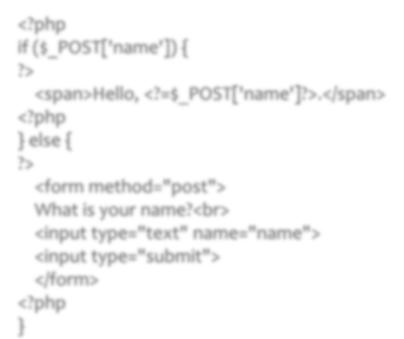

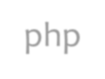
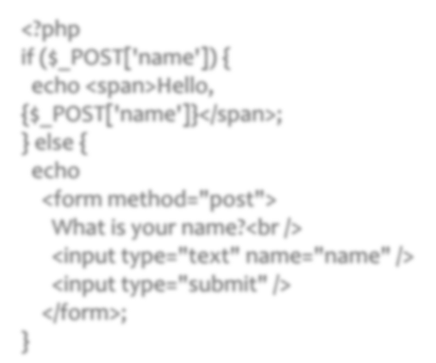


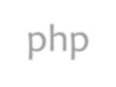



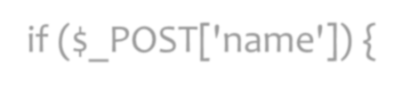
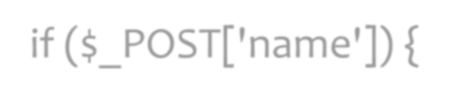




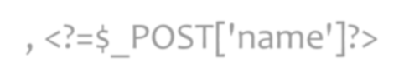
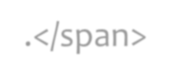
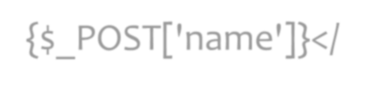
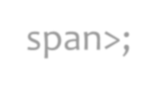
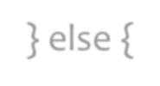
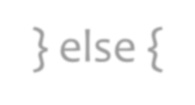
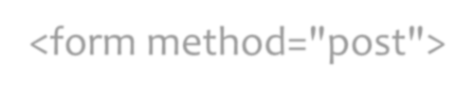
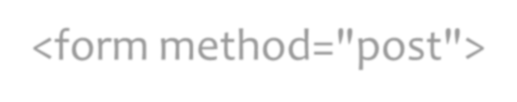





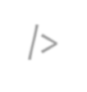
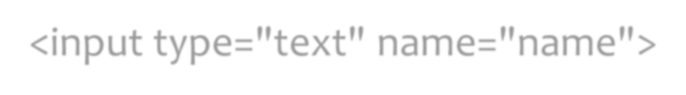
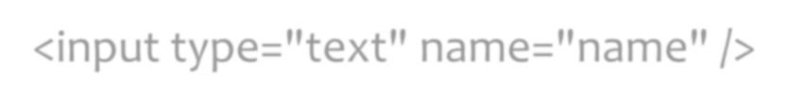
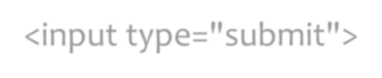
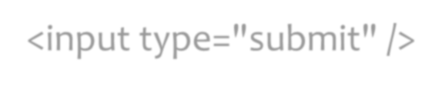
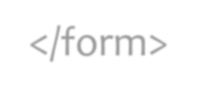
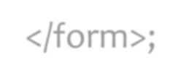


History
3
In 2010, Facebook released an extension for PHP called XHP.
XHP help to decrease XSS attack and make front-end much both readable and understand.
<?php
if ($_POST['name']) {
?>
<span>Hello, <?=$_POST['name']?>.</span>
<?php
} else {
?>
<form method="post">
What is your name?<br>
<input type="text" name="name">
<input type="submit">
</form>
<?php
<?php
if ($_POST['name']) {
echo <span>Hello,
{$_POST['name']}</span>;
} else { echo
<form method="post">
What is your name?<br />
<input type="text" name="name" />
<input type="submit" />
</form>;
PHP
}
XHP
}

Slide 3
History (cont)
´There was a distinct problem with XHP: dynamic web applications require many roundtrips to the server.
´XHP did not solve this problem.
A Facebook engineer negotiated with his manager to take XHP into the Browser using JavaScript and React comes into existence
React is a library for building composable user interfaces. It encourages the creation of reusable UI components which present data that changes over time

Slide 4
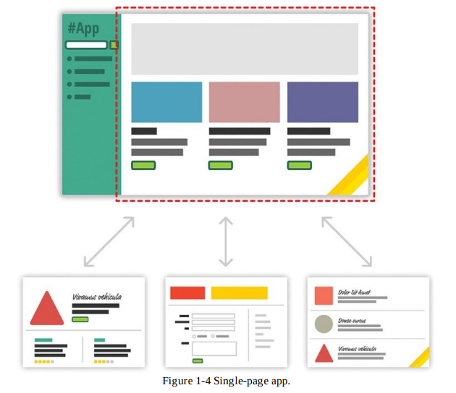

Slide 5
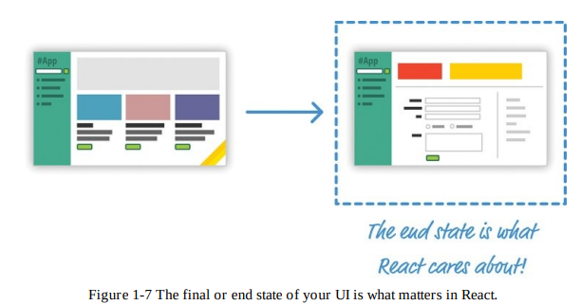

Slide 6
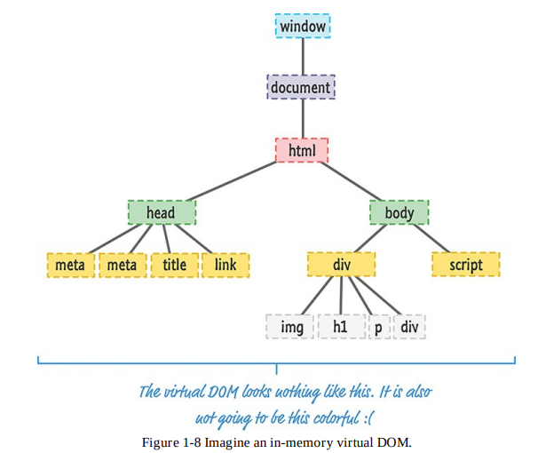

Slide 7
ReactJS {purpose}
5
 Creating user interface(V in MVC model).
 Building large applications with data that changes over time.
var React = React.createClass({ render: function() {
return (
<h1> Hello React </h1>
);
}
});
ReactDOM.render(<React />,document.getElementById('container'));

Slide 8

Advantages
Fast
Apps made in react can handle complex update and can still feel quick and responsive
Modular
Instead of writing large dense files, you can write many reusable files which makes maintainability pretty easy
Scalable
Large programs that displays a lot of changing data are where React performs best
Flexible
You can use react for interesting projects that have nothing to do with making a web application.
Popular
Understanding React will make you more employable as it has huge demand in market right now.

Slide 9
Sites Built with REACT
Facebook
Whatsapp web
Netflix
Instagram
BlankCursor
ProductHunt
Messenger.com

Slide 10
ReactJS {contents}
´ JSX
´ Virtual-DOM
´ Props
´ PropTypes
´ State
´ Refs
´ LifeCycle

Slide 11
ReactJS {JSX}
´ JSX is a JavaScript syntax extension that looks similar to XML. JSX stands for JavaScript XML
´ JSX allows us to write HTML elements in JavaScript and place them in the DOM
´ Make large trees easier to read than function calls or object literals.
const=<h1>HTML as JSX!</h1>; ReactDom.render(,.getElementById('root'));

Slide 12
ReactJS {JSX – examples}
HTML tags
var myDivElement = <div className="foo" > HTML tags </div>;
ReactDOM.render(myDivElement, document.getElementById('example'));
Component
var myElement = <MyComponent />;
ReactDOM.render(myElement, document.getElementById('example'));
9

Slide 13
In HTML, it’s common to use class as an attribute name:
<h1 class="big">Hey</h1>
In JSX, you can’t use the word class! You have to use className instead:
<h1 className="big">Hey</h1>
This is because JSX gets translated into JavaScript, and class is a reserved word in JavaScript.
When JSX is rendered, JSX className attributes are automatically rendered as class attributes.
Continued

Slide 14
ReactJS {Virtual-DOM}
15
 Problem:
 DOM manipulation is expensive.
 Re-render all parts of DOM make your app slowly.
 When the component’s state is changed, React will compare with DOM element to make smallest change.
 Is made by React.createElement().
 Whenever possible, does not update entire component in real DOM - only computes a patch operation that updates part of the DOM

Slide 15
Creating Component
Components are independent and reusable bits of code. They serve the same purpose as JavaScript functions, but work in isolation and returns HTML via a render function.
Create the component extending React.Component class
Implement the render() function.
Return the UI description.

Slide 16
ReactJS {JSX –Namespaced}
12
 What if you are building a component with many children? For example Form.
 Namespaced components help to make component simpler and easier.
 You just need to create your "sub-components" as attributes of the main component.

Slide 17

Nested
If a JSX expression takes up more than one line, then you should wrap the multi-line JSX expression
In Parentheses.
Nested JSX expressions can be saved as variables, passed to functions, etc., just like non-nested JSX
expressions

Slide 18
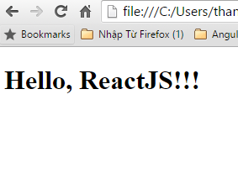
ReactJS {props}
19
 Used to pass parameter from parent to children.
. Properties are immutable
 var HelloReact = React.createClass({ render: function() {
return (
<h1> Hello, {this.props.name} </h1>
);
}
});
ReactDOM.render(<HelloReact name="ReactJS!!!" />, node);

Slide 19
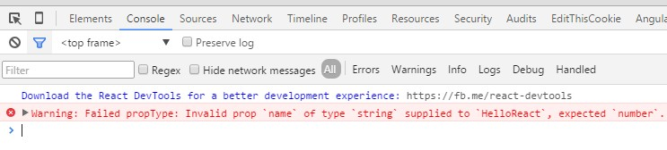
ReactJS {PropTypes}
21
 For validate the prop’s value input.
 var HelloReact = React.createClass({
propTypes: {
name: React.PropTypes.number
},
render: function() {
return (
<h1> Hello, {this.props.name} </h1>
);
}
});
ReactDOM.render(<HelloReact name="thanh" />, document.getElementById('content'));

Slide 20

Options to convert JSX into JS
Set up a development environment around Node and a handful of build-tools. In this environment, every time you perform a build, all of your JSX is automatically converted into JS and placed on disk for you to reference like any plain JavaScript file.
Let your browser rely on a JavaScript library to automatically convert JSX to something it understands. You specify your JSX directly just like you would any old piece of JavaScript, and your browser takes care of the rest.

Slide 21
Installing React
The following CLI commands help install React :
npm install -g create-react-app
create-react-app hello-world
cd hello-world
npm start
Uses webpack, Babel and ESLint under the hood but configures them automatically.
Doesn’t handle background logic or databases; just creates a frontend build pipeline to use with any backend

Slide 22
C:\NorthEasternTeaching\WebDesignAndUserExperienceEngineering\Spring 2021\Lecture 8>npm install -g create-react-app
C:\Users\vishal chawla\AppData\Roaming\npm\create-react-app -> C:\Users\vishal chawla\AppData\Roaming\npm\node_modules\create-react-app\index.js
+ create-react-app@4.0.3
added 67 packages from 25 contributors in 23.162s
C:\NorthEasternTeaching\WebDesignAndUserExperienceEngineering\Spring 2021\Lecture 8>create-react-app helloworld
Creating a new React app in C:\NorthEasternTeaching\WebDesignAndUserExperienceEngineering\Spring 2021\Lecture 8\helloworld.
Installing packages. This might take a couple of minutes.
Installing react, react-dom, and react-scripts with cra-template...

Slide 23
Success! Created helloworld at C:\NorthEasternTeaching\WebDesignAndUserExperienceEngineering\Spring 2021\Lecture 8\helloworld
Inside that directory, you can run several commands:
npm start
Starts the development server.
npm run build
Bundles the app into static files for production.
npm test
Starts the test runner.
npm run eject
Removes this tool and copies build dependencies, configuration files
and scripts into the app directory. If you do this, you can’t go back!
We suggest that you begin by typing:
cd helloworld
npm start
Happy hacking!
Changing Port
“scripts”: { “start”: “set PORT=4000 && react-scripts start” }

Slide 24
REACT SUMMARY
We can create our own components
We can nest components as we like
Stateless Function components are pure
We can control flow via JS(if, else, for, map ….)

Slide 25
Resources
To Start: W3schools react
Learning React – By Kirupa Chinnathambi
Documentation and examples: https://reactjs.org/
Angular and Redux: Nate Murray

